Slide 1



CONSCIENT SOHO

Slide 2
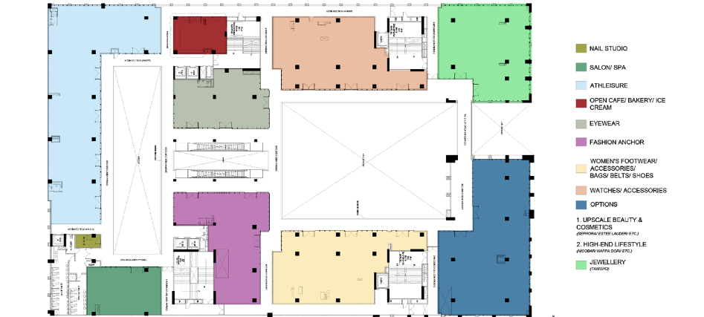
ZONING PLAN – FIRST FLOOR

Slide 3
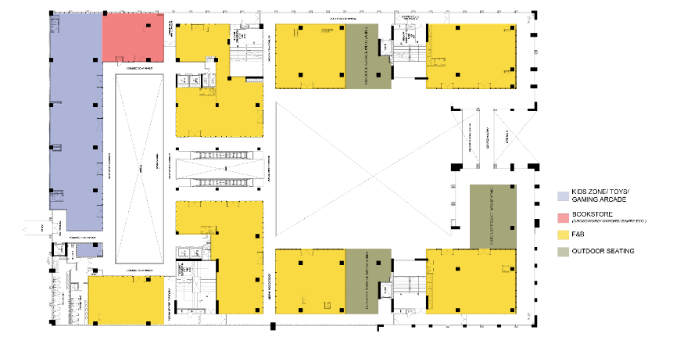
ZONING PLAN – SECOND FLOOR

Slide 4
THANK YOU

